Slide 1
Predicting Heart Disease
Will Jaekle
October 14th 2021
Brown Data Science Initiative
https://github.com/wjaekle/heart_project.git

Slide 2

Intro
Heart disease accounts for 17.9 million deaths a year
These deaths are largely preventable given enough time
Attributes include:
Age, Sex, Chest Pain type, Resting Blood Pressure, Cholesterol, Fasting Blood Sugar,
Resting ECG classification, Maximum observed Heart rate, Exercise induced angina,
And notably, Oldpeak, and ST slope.
Target: Heart Disease 45% False, 55% True

Slide 3
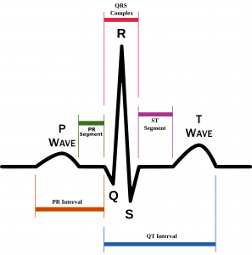
Intro (cont.)
Fasting blood sugar: is blood sugar > 120 mg/dl while fasting?
ST slope, Old peak and resting ECG?
We can combine these to
form a classification Algorithm.

Slide 4
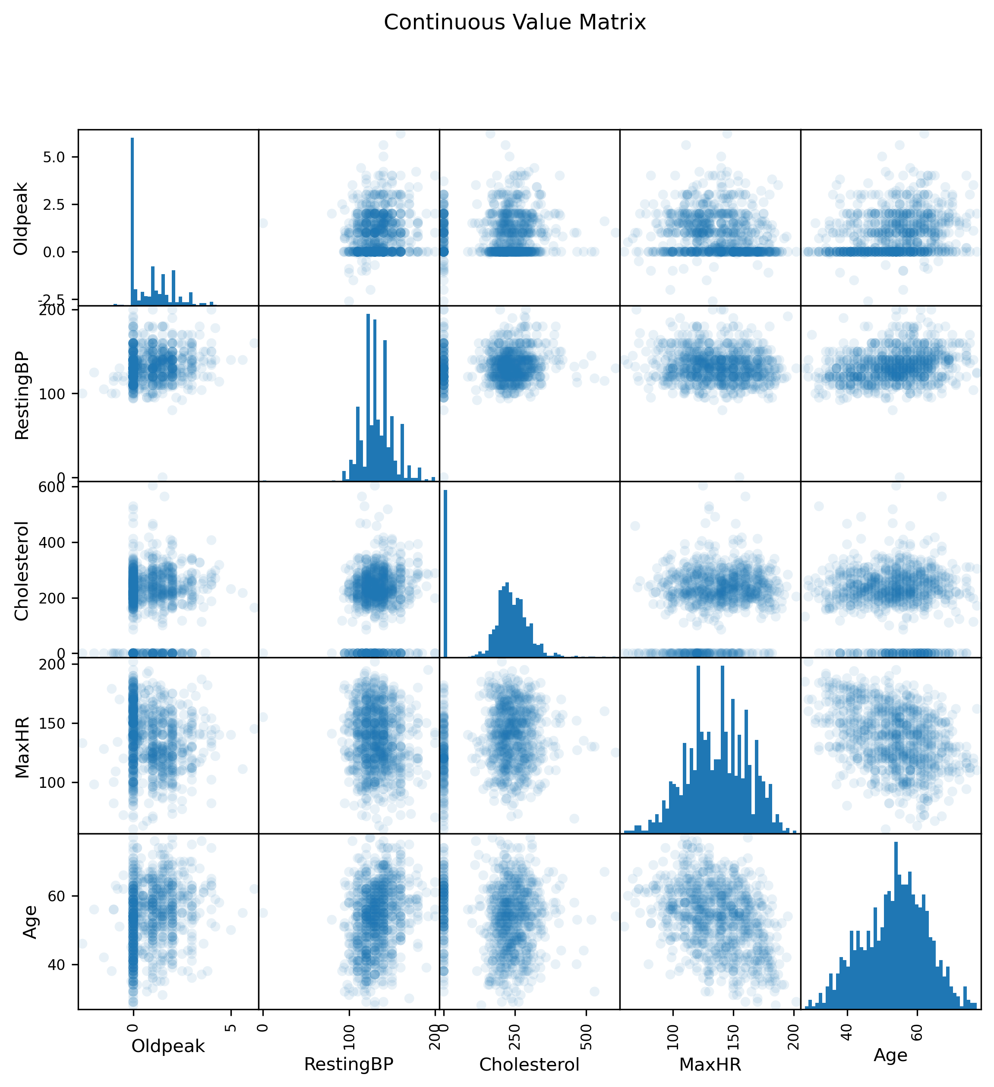
EDA:
Continuous Variable Scatter Matrix
Strange Values
Lack of correlation

Slide 5
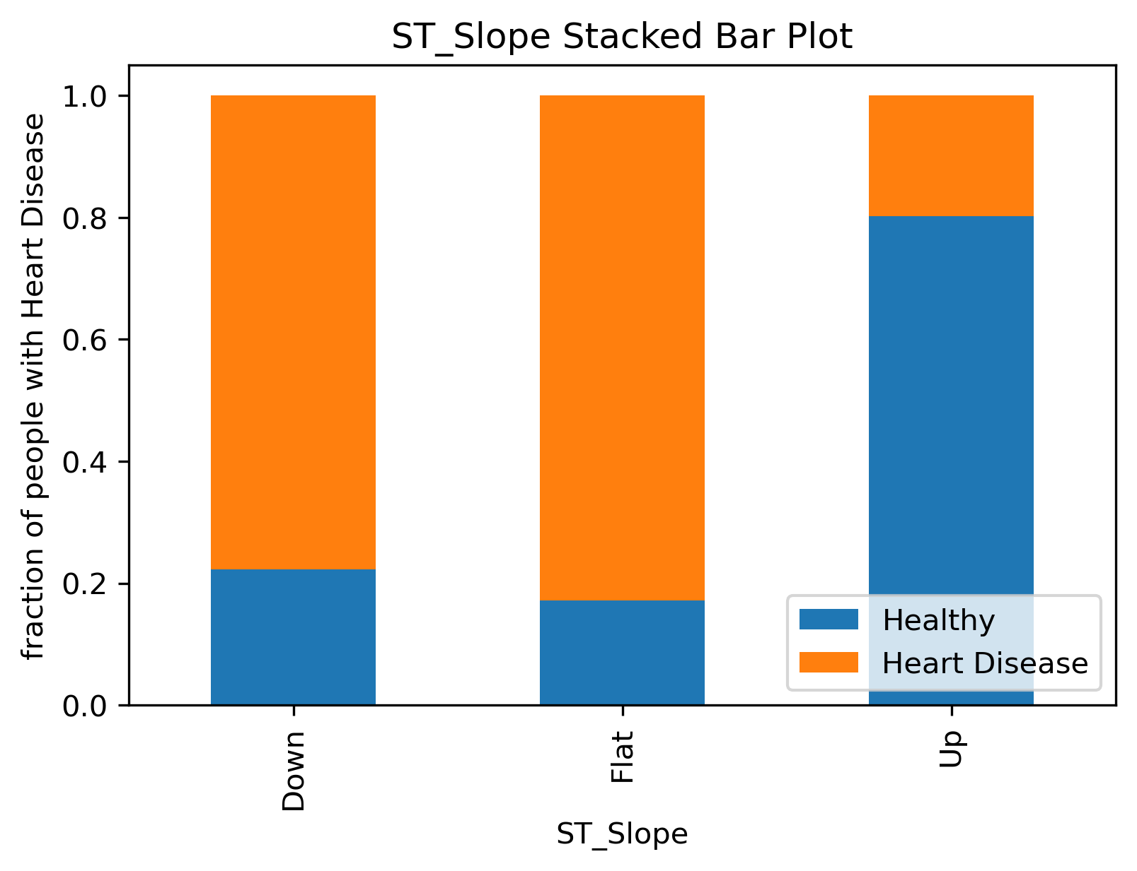
EDA Important features: ST slope
The most predictive
categorical feature.
(Up and flat are the
Majority of patients)

Slide 6
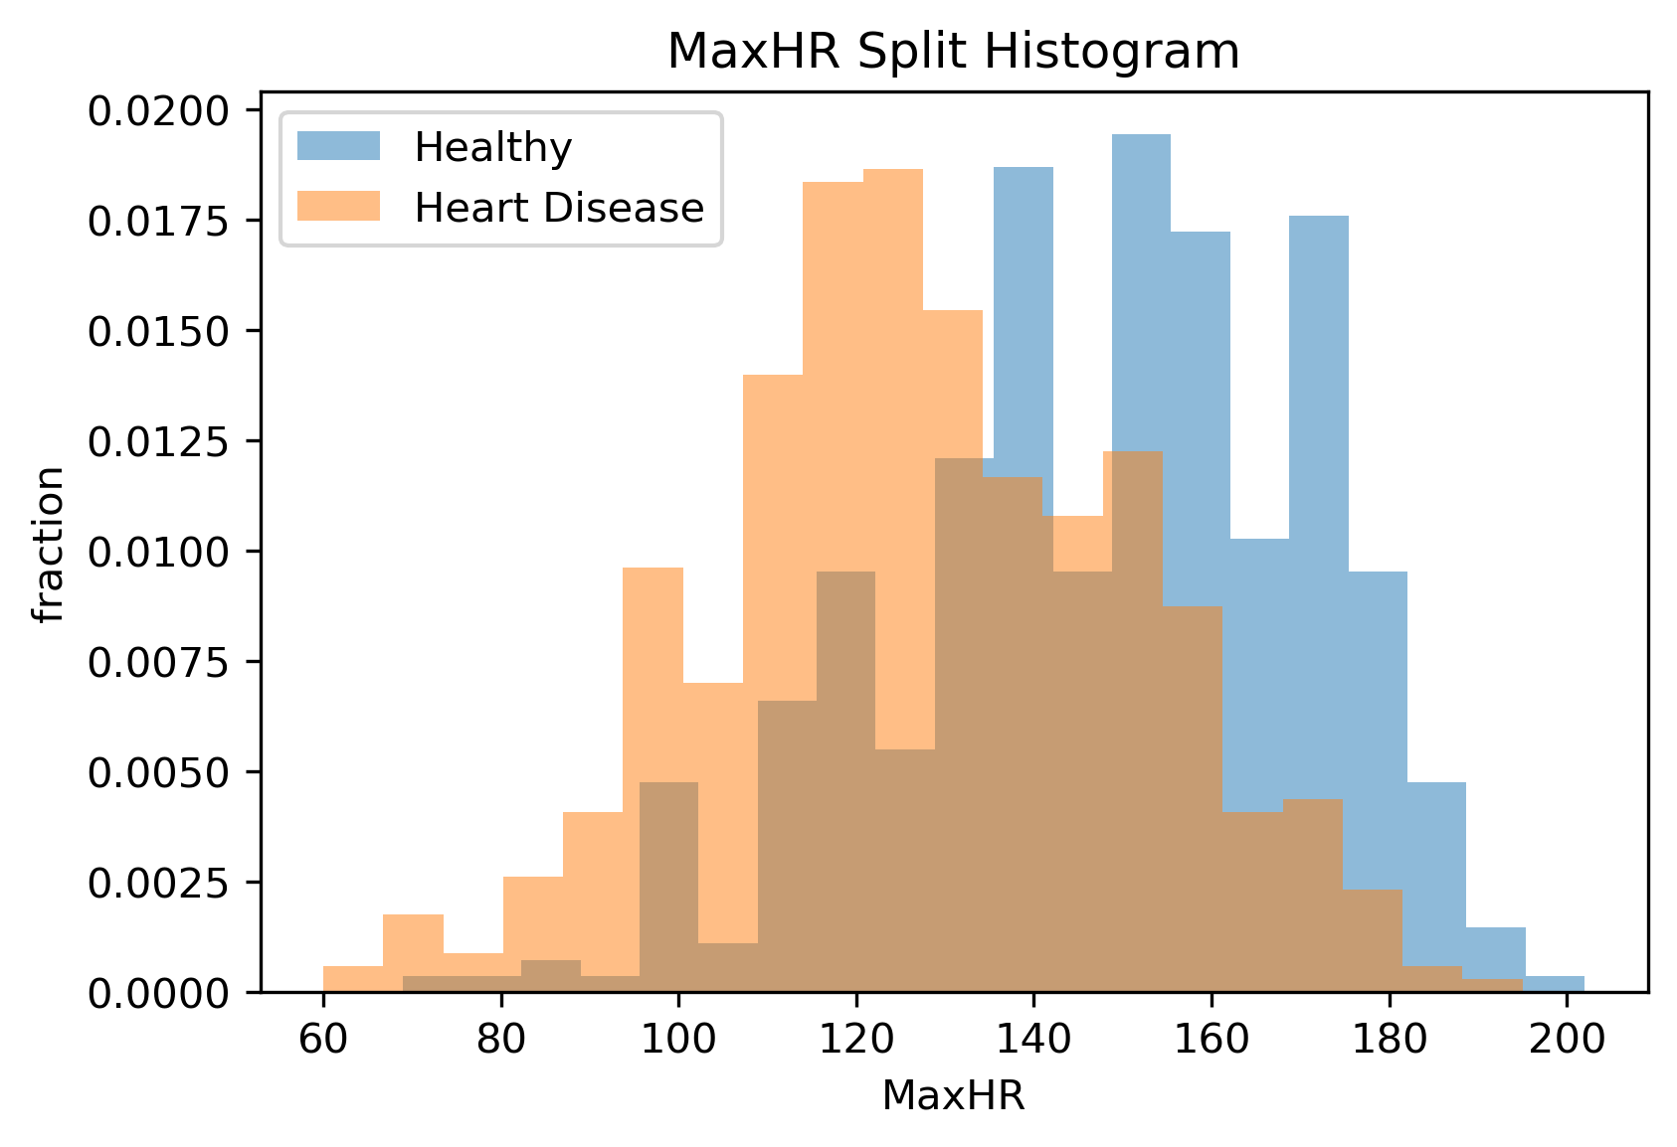
EDA Important features: MaxHR
The most predictive
continuous feature.

Slide 7
Splitting and preprocessing Summary
Data set is ‘small’ so the splits were 70% 15% 15% respectively.
IID ✅
Wrote 0 to nan where appropriate
21 features after preprocessing
Minmax : Age Resting Blood Pressure, Cholesterol, Maximum observed Heart Rate
Standard: Oldpeak
OneHot: Sex, Chest Pain type, Fasting Blood Sugar,
Resting ECG classification, Exercise induced angina, and ST slope.

Slide 8
Why One Hot?:
Chest Pain type:
TA = Typical Angina, ATA= Atypical Angina, NAP= Non-Anginal Pain, ASY= Asymptomatic
Resting ECG:
Normal= Normal, ST: having ST-T wave abnormality, LVH = showing probable or definite left ventricular hypertrophy

Slide 9
Questions?

